Slide 1



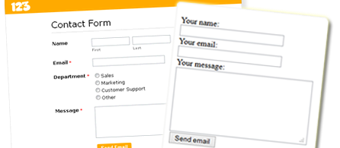
Creating CRUD Applications
CRUD
Workshop
SoftUni Team
Technical Trainers
Software University
http://softuni.bg

Slide 2
Questions
sli.do #PHP-WEB

Slide 3

DB Drivers Exercise
Live Demo

Slide 4
PDO Wrapper
Database Interface
Prepared Statement Interface
ResultSet Interface

Slide 5
Database Exception
On connection
On execution
On data

Slide 6
First CRUD Exercise
Live Demo

Slide 7
Extend application
Form submission checks
throw exception
catch exception
use current view
Successful (flash) messages
Global Error Handler
No nullable return types

Slide 8








Creating CRUD Applications
https://softuni.bg/courses/php-basics/

Slide 9
License
This course (slides, examples, demos, videos, homework, etc.) is licensed under the "Creative Commons Attribution-NonCommercial-ShareAlike 4.0 International" license
Attribution: this work may contain portions from
"PHP Manual" by The PHP Group under CC-BY license
"PHP and MySQL Web Development" course by Telerik Academy under CC-BY-NC-SA license

Slide 10





Free Trainings @ Software University
Software University Foundation – softuni.org
Software University – High-Quality Education, Profession and Job for Software Developers
softuni.bg
Software University @ Facebook
facebook.com/SoftwareUniversity
Software University @ YouTube
youtube.com/SoftwareUniversity
Software University Forums – forum.softuni.bg

